Slide 1




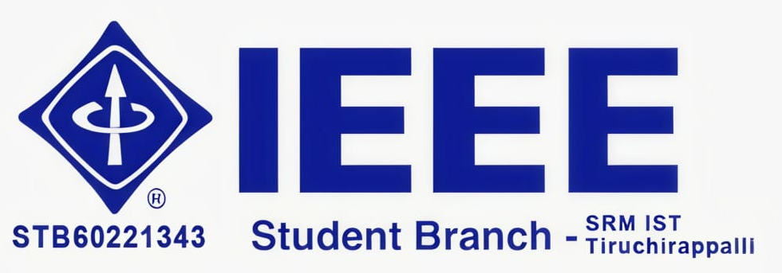
Mega-Thon
SYNAPSE-EDU : CLOSED-LOOP EDUCATIONAL INTELLIGENCE PLATFORM
Adaptive Learning | Voice-First AI Viva | Teacher Cohort Intelligence | Automated Remediation
Team name: Nightfarers
Team members: Ayon Mukherjee, Shubham Mallick, Shreyash Jha, Soham Choudhury
College/organization: SRM Institute of Science and Technology Trichy
Team leader/contact: Ayon Mukherjee / 8102429090
Track name: EduGenAI
Problem statement : Due to a 1:100 faculty-to-student ratio, regular 1-on-1 oral vivas are impossible, leaving students stuck in passive rote learning and copy-paste cheating.
Consequently, professors only discover critical conceptual misconceptions after semester exam results—when it is already too late for timely remediation.
TEAM DETAILS
TRACK & PROBLEM
@ YUVA MEGA-THON Submission template

Slide 2
Mega-Thon
Problem Statement: The Broken Educational Feedback Loop
Passive Courseware
70% Knowledge Drop
• Students passively consume static PDFs & PPTs without personalized pacing or dynamic conceptual breakdown.
• Forces rote memorization rather than deep intuitive problem-solving.
Viva Bottleneck
1:100 Professor Ratio
• Oral viva tests true conceptual mastery, but professors cannot conduct 15-minute 1-on-1 vivas for 100+ students regularly.
• Leads to high student anxiety and zero low-stakes verbal practice.
Blind Remediation
Delayed Diagnostics
• Teachers only discover misconceptions weeks later in semester finals—when it is too late for timely pedagogical intervention.
• No automated way to identify cohort-wide learning flaws.
PAIN 01
PAIN 02
PAIN 03
WHY IT MATTERS: Bloom's 2-Sigma Mastery Imperative
1-on-1 personalized tutoring elevates student outcomes by 2 standard deviations (98th percentile). SynapseEdu automates this closed loop at zero marginal cost.
@ YUVA MEGA-THON Submission template

Slide 3
Mega-Thon
Proposed Solution: The Closed-Loop Architecture
INGESTION
Curriculum RAG Engine
• Teacher uploads PDF/PPT/Text notes.
• LangChain chunks text & embeds with Gemini text-embedding-004 into FAISS vector index.
ADAPTATION
Concept Transformer
• Re-articulates complex curriculum dynamically.
• Tailors mathematical depth, tone, and real-world analogies to individual student baseline.
VIVA EXAM
Voice Socratic Viva
• Real-time oral assessment via Google STT.
• Gemini asks progressive Socratic follow-ups to probe reasoning depth and catch rote guessing.
REMEDIATE
Teacher Copilot Loop
• Auto-generates 5-min remediation for score < 60%.
• Surfaces cohort misconception heatmaps for instructor classroom intervention.
STEP 01
STEP 02
STEP 03
STEP 04
THE CLOSED LOOP: Learn -> Voice Viva -> Misconception Diagnostic -> Instant Remediation -> Teacher Action
Ensures no student gets left behind while giving educators continuous real-time diagnostic visibility.
@ YUVA MEGA-THON Submission template

Slide 4
Mega-Thon
Innovation & Uniqueness: How We Stand Apart
Evaluation Criteria | Generic Chatbots | Traditional LMS | Quizlet / Anki | SynapseEdu (Ours)
Courseware RAG Grounding | Manual paste / Hallucinates | No semantic search | Static card decks | Automated Multi-Format RAG
Oral Assessment / AI Viva | None (Text prompt only) | None (Rigid MCQ) | None (Flashcards) | Voice Socratic Viva (STT)
Root Misconception Profiling | Generic text advice | Right / Wrong score only | Binary recall score | Cognitive Misconception Map
Automated Micro-Remediation | Requires manual prompt | None (Manual teacher work) | Repeat static card | Auto 5-Min Remediation Lesson
Teacher Cohort Intelligence | None (Consumer tool) | Basic gradebook tables | None | Live Real-Time Concept Heatmaps
CORE ARCHITECTURAL EDGE: Pedagogical Integrity & Anti-Cheating
Oral voice vivas prevent AI copy-paste cheating while testing genuine articulation and cognitive reasoning.
@ YUVA MEGA-THON Submission template

Slide 5
Mega-Thon
Target Users: Transforming the Educational Ecosystem
Higher Ed & Engineering Students
Primary Learner & Test Taker
• Practice technical lab vivas and campus placement interviews on-demand.
• Experience low-stakes oral defense with zero judgment and instant micro-remediation.
Professors & Teaching Assistants
Course Creator & Evaluator
• Eliminates 15+ hours/week spent on repetitive oral grading and manual quiz creation.
• Real-time class heatmaps reveal exactly which lecture concepts failed to register.
PERSONA 01
PERSONA 02
Academic Deans & Institutions
Continuous Assessment & Accreditation
• Fulfill Outcome-Based Education (OBE) and continuous assessment compliance.
• Early-warning indicators identify struggling students weeks before mid-term/final exams.
Competitive Exam & Certification Aspirants
GATE / GRE / Tech Upskilling
• Rigorous active recall practice through conversational Socratic interrogation.
• Deep conceptual mastery of algorithms, circuits, mathematics, and systems design.
PERSONA 03
PERSONA 04
@ YUVA MEGA-THON Submission template

Slide 6
Mega-Thon
Key Features: 6 Pillars of Intelligent Tutoring
RAG Courseware Ingestion
PyPDF2 & LangChain parsing of PDFs, slides, and notes into FAISS vector embeddings.
Adaptive Concept Transformer
Dynamic re-explanation of concepts with analogies tailored to student history.
Voice Socratic AI Viva
Low-latency oral examination via Google STT and Gemini with progressive follow-ups.
FEATURE 01
FEATURE 02
FEATURE 03
Multi-Metric Evaluator
Scores answers on conceptual precision, missing principles, and reasoning depth.
5-Min Remediation Trigger
Auto-synthesizes micro-lessons whenever concept mastery falls below 60%.
Teacher Copilot Heatmap
Live class cohort analytics, topic mastery distributions, and one-click remediation.
FEATURE 04
FEATURE 05
FEATURE 06
@ YUVA MEGA-THON Submission template

Slide 7
Mega-Thon
Technology Stack: Robust Full-Stack AI Architecture
Core Logic & Web
• Python 3.10+ (AI pipeline & async services)
• TypeScript / JavaScript (ES6+ Web UI)
• SQL (Mastery Profile Store)
Modern Full-Stack
• FastAPI (High-concurrency async Python backend)
• React.js (Component-driven responsive SPA)
• TailwindCSS (Accessible UI components)
Generative Reasoning
• Google Gemini 1.5 / 2.0 Flash API
• Gemini text-embedding-004
• BAAI bge-small (Local Vector Fallback)
LANGUAGES
FRAMEWORKS
AI / ML MODELS
Low-Latency Speech
• Google Cloud Speech-to-Text (STT) API
• Browser Web Speech API (Low-latency)
• WebRTC & MediaRecorder Stream
Semantic Search & Data
• FAISS (Sub-50ms vector similarity index)
• ChromaDB (Persistent vector store)
• MySQL / Firebase (Student mastery graphs)
Production DevOps
• LangChain & PyPDF2 (Chunking pipelines)
• Docker containerization
• Google Cloud Run / Vercel
VOICE & MULTIMODAL
VECTOR & DATABASE
DEPLOY & TOOLING
@ YUVA MEGA-THON Submission template

Slide 8
Mega-Thon
Implementation Plan: 36-Hour Hackathon Roadmap
Phase 1: Foundation
• FastAPI scaffold & API schemas
• PDF text extraction via PyPDF2
• LangChain chunking & FAISS index
Phase 2: Voice Viva
• Google STT voice recording in React
• Gemini Socratic viva prompt chains
• Multi-metric answer scoring logic
Phase 3: Remediation
• Auto 5-min micro-lesson synthesis
• Concept mastery profile in DB
• Remediation trigger for score < 60%
Phase 4: Copilot & MVP
• Teacher class mastery heatmap UI
• End-to-end integration & testing
• 2-minute demo video & pitch polish
HOURS 00 - 08
HOURS 08 - 18
HOURS 18 - 28
HOURS 28 - 36
MINIMUM VIABLE PROTOTYPE (MVP SCOPE AT 36 HOURS)
100% Working Closed Loop: Teacher uploads PDF -> Student takes 3-question voice viva -> Real-time scoring -> Instant 5-min remediation lesson -> Live teacher cohort analytics.
@ YUVA MEGA-THON Submission template

Slide 9
Mega-Thon
Expected Impact: Quantifiable Educational Value
80% RETENTION
Active Recall vs Reading
Verbal articulation under Socratic questioning dramatically boosts long-term conceptual retention over passive reading.
90% TIME SAVED
Teacher Grading Overhead
Automates continuous oral viva diagnostics, freeing instructors to focus on high-leverage 1-on-1 student mentorship.
100% REAL-TIME
Instant Remediation
Identifies and repairs root misconceptions immediately with 5-minute micro-lessons before exams approach.
ZERO COST
NEP 2020 Democratization
Delivers Ivy-League-level 1-on-1 Socratic tutoring to Tier-2, Tier-3, and rural institutions at negligible marginal cost.
POLICY & INDUSTRY IMPACT: National Education Policy (NEP 2020) & Placement Readiness
Fulfills continuous competency-based evaluation mandates while preparing engineering students for rigorous technical placement interviews.
@ YUVA MEGA-THON Submission template

Slide 10
Mega-Thon
Feasibility & Risk Mitigation: Engineering Rigor
100% Achievable Within Hackathon Sprint:
• Decoupled Microservices: FastAPI endpoints (/upload, /viva, /evaluate, /analytics) allow backend and frontend to build concurrently.
• Turnkey Google AI SDKs: Gemini API and Google Cloud STT eliminate custom ML training time, enabling 100% focus on RAG pipelines.
• Pre-Built Tailwind UI: React component library enables rapid responsive assembly of student and teacher interfaces in under 8 hours.
Identified Technical Risks & Solutions:
• Speech Recognition Latency: Mitigated via browser-native Web Speech API with seamless fallback to Google Cloud STT.
• Vector DB Overhead: In-memory FAISS vector index guarantees sub-50ms local embedding retrieval without external cluster lag.
• LLM Hallucination Risk: Strict RAG context injection and low temperature (T <= 0.2) ensure viva questions stay grounded in syllabus.
WHY 36H FEASIBLE
RISK & MITIGATION MATRIX
@ YUVA MEGA-THON Submission template

Slide 11
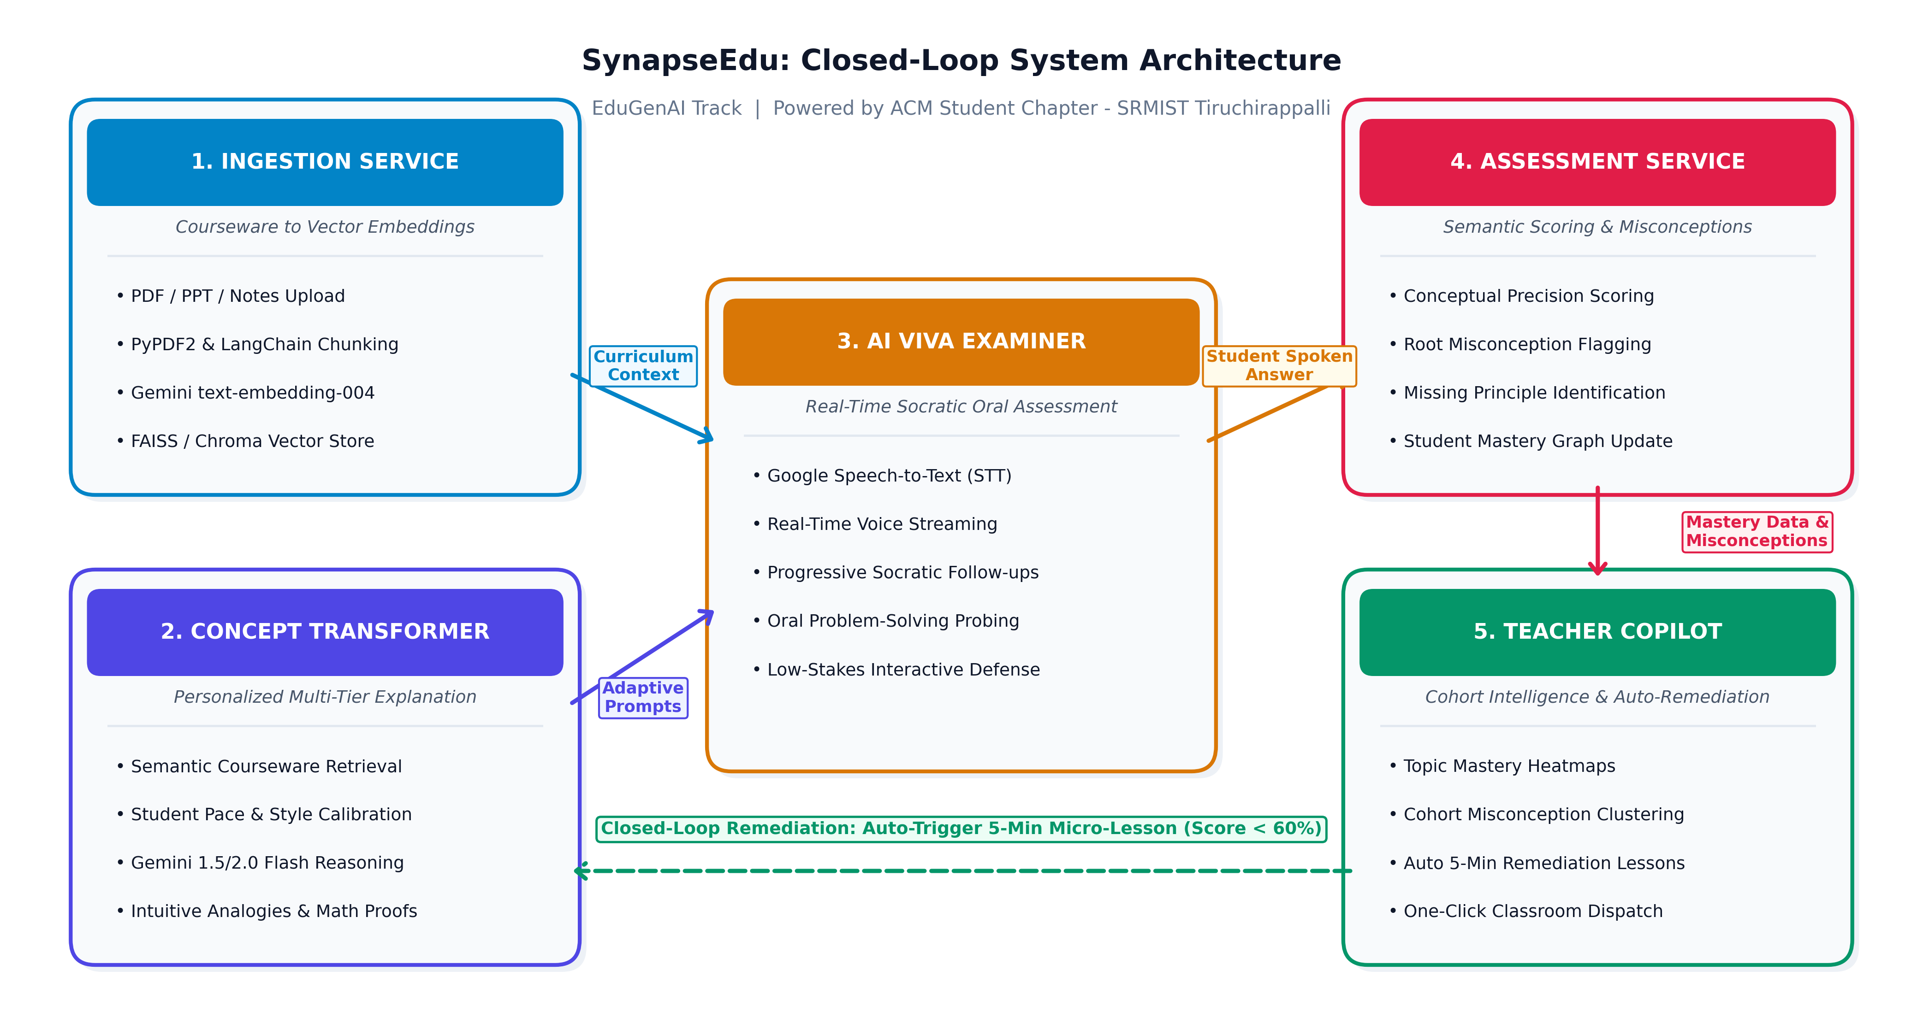
Mega-Thon
Prototype & System Architecture Flow
Artifacts & References:
• GitHub Repository: FastAPI backend & React SPA with OpenAPI schemas and prompt definitions.
• Figma UI Prototype: Interactive mockups of Student Voice Viva Portal & Teacher Heatmap.
• Live Demo Video: 2-minute demonstration of full PDF ingestion to voice viva to remediation.
• Bloom's 2-Sigma Study: Mastery learning via continuous 1-on-1 tutoring.
• RAG (Lewis et al.): Retrieval-augmented grounding for hallucination-free academic evaluation.
PROJECT DELIVERABLES
@ YUVA MEGA-THON Submission template

Slide 12
Mega-Thon
Executive Pitch: Transforming Education
"SynapseEdu closes the loop in education by transforming static courseware into adaptive voice-driven AI vivas, diagnosing root misconceptions in real time, and empowering teachers with automated cohort intelligence and instant remediation."
THE ONE-LINE PITCH
Active Oral Mastery
Conquers viva anxiety through private on-demand voice practice, receiving instant targeted 5-minute micro-lessons.
90% Grading Relief
Automates continuous diagnostic assessment while live heatmaps spotlight exactly which concepts require in-class focus.
Accredited OBE Quality
Continuous Outcome-Based Education (OBE) and NBA/NAAC compliance metrics delivered across large batches at zero marginal cost.
FOR STUDENTS
FOR EDUCATORS
FOR INSTITUTIONS
@ YUVA MEGA-THON Submission template

